Slide 1




Sheffield & District Junior Sunday Football League
New Managers Meeting

Slide 2
Agenda
About the League
Life as a Club Secretary
Life as a Team Manager
Where to go for help
Q&A

Slide 3
This presentation will only briefly touch on the working practices, rules and regulations of the League
This presentation is not a substitute for reading the League rules - You will still need to read
For more information and updated news during the season keep visiting the League website and subscribe to the League newsletter.

Slide 4
The League is NOT the FA
The league is....
the MEMBER CLUBS

Slide 5

Role of the League
Issuing of league fixtures
Registration of players
Updating the League website
Dealing with League application forms
Enforce League rules (as set by member clubs)
Enforce the Standard Code of Rules (as set by the FA)

Slide 6

Role of the CFA
•
•
•
•
•
•
•
•
•
•
•
•
Club Development
FA Accreditation
Coach Development
Updating the County FA website
Player Suspensions
County FA affiliation forms
Club Suspensions
Deal with any “poaching” issues
Referee performances
Football Debt Recovery scheme
Child Welfare
Enforce the Rules of the Association

Slide 7
The League is in a partnership deal with

Slide 8

We are:

Slide 9

We are:
An FA Respect League

Slide 10
League Playing Formats
Format
U7 |  |  |  |  |  | 5v5
U8 |  |  |  |  |  | 5v5
U9 |  |  |  |  |  | 7v7
U10 |  |  |  |  |  | 7v7
U11 |  |  |  |  |  | 9v9
U12 |  |  |  |  |  | 9v9
U13 |  |  |  |  |  | 11v11*
U14 |  |  |  |  |  | 11v11
U15 |  |  |  |  |  | 11v11
U16 |  |  |  |  |  | 11v11
2014/15 2015/16 2016/17 2017/18 2018/19
5v5 5v5 5v5 5v5 5v5 5v5 5v5 5v5 5v5 5v5 7v7 7v7 7v7 7v7 7v7 7v7 7v7 7v7 7v7 7v7 9v9 9v9 9v9 9v9 9v9 9v9 9v9 9v9 9v9 9v9 11v11 * 11v11* 11v11* 11v11 * 11v11*
11v11 11v11* 11v11* 11v11* 11v11
11v11 11v11 11v11* 11v11 11v11
11v11 11v11 11v11 11v11 11v11

Slide 11
League Tables
Format
U7 |  | NO
U8 |  | NO
U9 |  | NO
U10 |  | No
U11 |  | No
U12 |  | Yes
U13 |  | Yes
U14 |  | Yes
U15 |  | Yes
U16 |  | Yes
2014/15 2015/16 2016/17 2017/18 2018/19
NO NO NO NO NO NO NO NO NO NO NO NO NO NO NO
No No No No No Yes No No No No Yes Yes Yes Yes Yes Yes Yes Yes Yes Yes Yes Yes Yes Yes Yes Yes Yes Yes Yes Yes Yes Yes Yes Yes Yes

Slide 12
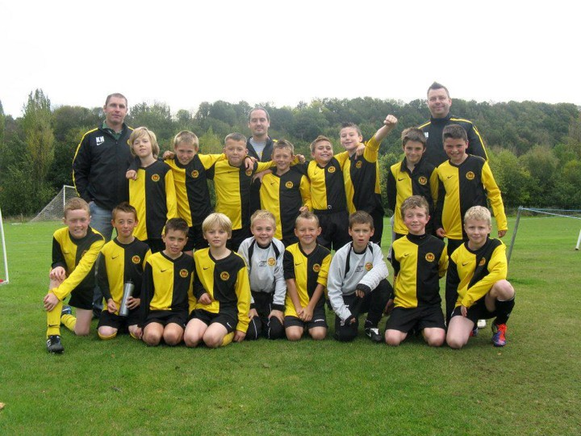
We Do:
Support clubs
Put Funding opportunities on the League website as well as provide funding opportunities from the league.
Put news on the League website
Have a fantastic committee who are willing to give up their own free time in order to keep teams running smoothly.

Slide 13
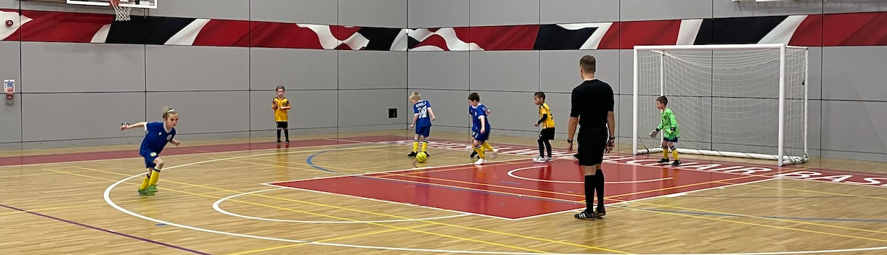
We Do:
Ask For Suggestions on how to improve by:
League surveys
Hold annual league development days

Slide 14

We Do:
Support Taking Football to Africa & Beyond
The League is collecting old kit to support the Taking Football to Africa and Beyond Appeal.
In the past year a number of clubs have supported this charity by donating old kit. If you have any old kit please email the League Secretary

Slide 15
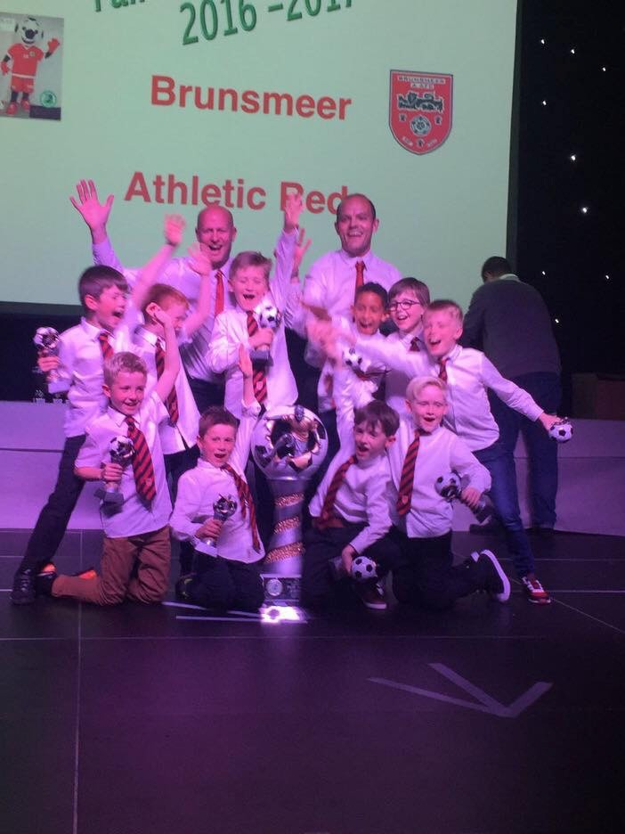
We Do:
Reward Fair Play
Each manager for every League fixture scores the spectators/ Management and players and those marks are added together to create one score. These sporting points are added up at the end of the season and an average created.
The overall age-group winner is awarded a very large and impressive fair play trophy for the club with smaller versions of the same trophy for each player and awards from our Respect Sponsor

Slide 16



We Do:
Support Respect Campaigns

Slide 17
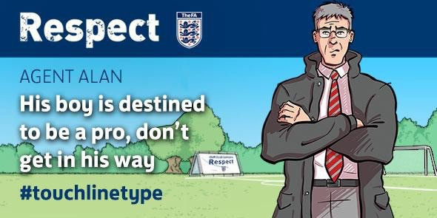





Slide 18
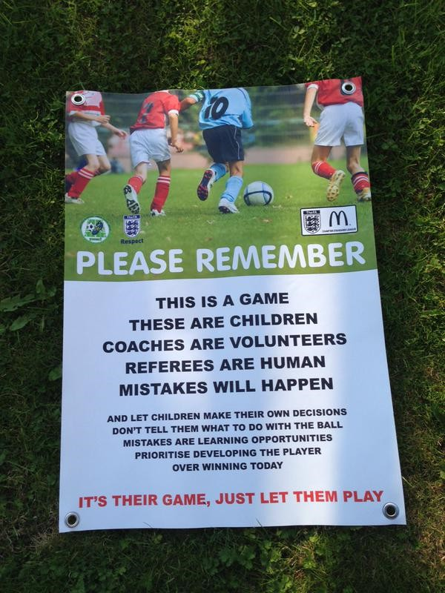
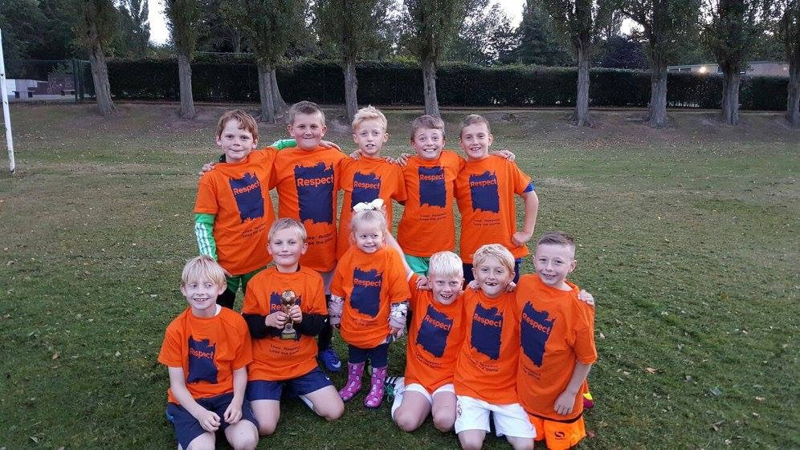
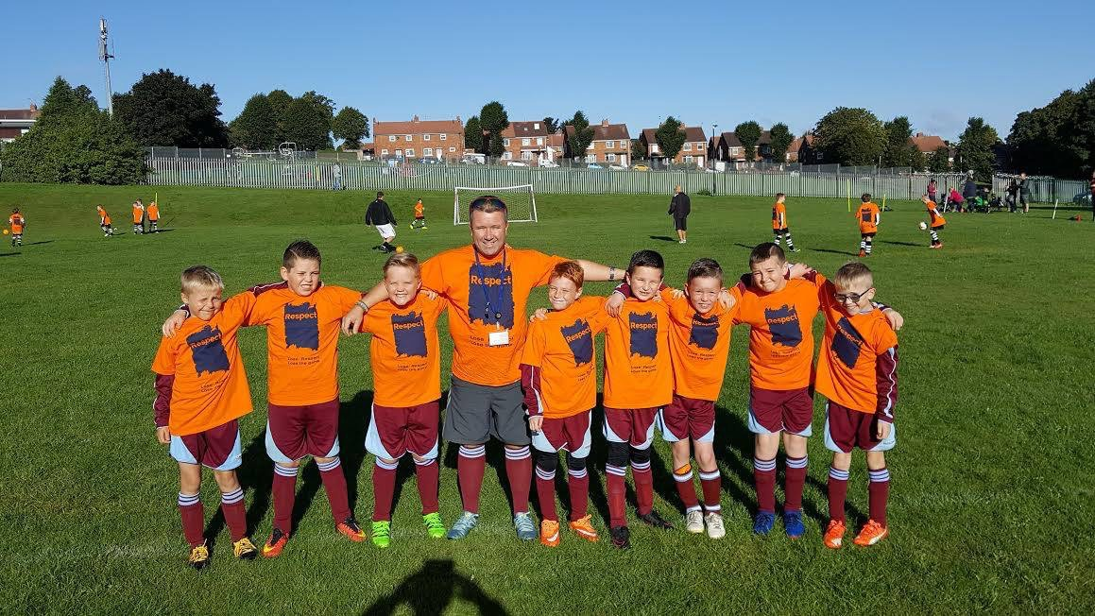

Slide 19
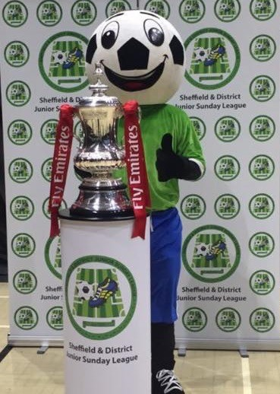
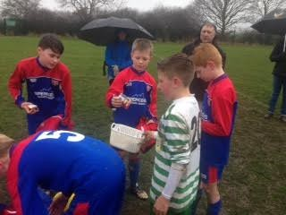

Slide 20

We have:
5 end of season presentation evenings
These are attended by over 6,000 people These presentation evenings reward divisional
winners and runners-up but more importantly each U12+ age-group Fair Play Winner receives the recognition they deserve.

Slide 21
Life as a Club Secretary

Slide 22
The Club Secretary is……
The MOST important role in the club

Slide 23
Job Description:
What is the role of the Club Secretary?
Principle Administrator for The Club
Carries out full Club admin duties
Main point of contact for people within and outside the Club
Representative of the Club at outside meetings

Slide 24
What sort of tasks are involved?
Attending league meetings;
Affiliating the club to the County FA;
Affiliating the club to the league(s);
Registering players to the league(s);
Dealing with correspondence;
Organising and booking match facilities for the season;
Organising the club AGM and other club meetings;
Representing the club at meetings
Dealing with League admin
Dealing with County FA admin
Dealing with issues around misconduct – Whole Game System

Slide 25
This section looks at the responsibility each TEAM/ CLUB has to the League.
Note the functions listed do not have to be performed by the Team manager but MUST be done by someone within the team or club.

Slide 26
Pre-Season
Registering Players
Players can be registered from the 1st June and all registrations cease on the 31st May.
Please refer to the player registration guidance on the league website. It can be found under forms → Player Forms.
A teams worth of players must be registered on or before the 20th August. If not, a charge will be raised against the team.
Only Players with a valid Squad Sheet can play NO SQUAD Sheet – NO GAME – NO EXCEPTIONS

Slide 27
Life as a Team Manager

Slide 28
During the Season
If you are the home team, give your opponents at least FIVE Days clear notice of the match arrangements (Kick Off time, venue, Referee, and your kit colours).
For each home match the home team need to provide a QUALIFIED & REGISTERED referee. If the home team cannot do this, then they need to offer their opponents the opportunity to provided a QUALIFIED & REGISTERED referee. If neither team can do this, then they need to agree on a stand-in official. More in-depth details are on the League website.
Prior to each fixture you need to make sure the fixture is showing on the FA Full-Time site. If it does not appear, then inform your age-group registrar to make sure it does appear.

Slide 29
During the Season
Prior to any game you need to make sure you have with you:
League Handbook (use this as a point of reference if you have any questions whilst at the game)
Player Squad Sheets - they need to be inspected before kick off
First Aid Kit
League officials can ask to inspect on a match day to see if you have any of these items available. Failure to do so, will result in a charge, and in the case of a Player not on the Squad Sheet, those players WILL NOT BE ABLE TO PLAY.
You must have a RESPECT BARRIER / cones / rope that prevents spectators from standing on the touchline
Technical Areas – No longer can managers go running down the touchline. All managers (max of 3) must be in the technical area

Slide 30
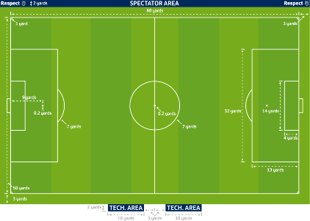

Slide 31
During the Season
Prior to any game who need to make sure you do:
Give your opponents (and the ref, it they ask for it) a list of your players who are playing
Check your opponents Squad Sheets against the list of players supplied by your opponents.
No Squad Sheet - No game - No Exceptions
If it is found a player has played not on the Squad Sheet, both teams will be charged
Perform the Respect Handshake
TIP: Line the players and check Squad Sheets against the playing list and then move on to the Respect handshake.

Slide 32
During the Season
Before, during and after the game:
Be respectful to all participants (players and match officials)
Remember you are representing YOUR Club
Any incidents that occur on or around the field of play will be dealt with by the County FA – You have a duty to report them

Slide 33
During the Season
After the game:
By 10pm on a Matchday, the result must appear on the FA Full Time site
By 5 days, the match sheet must be completed on the FA Full Time Site

Slide 34
The Result needs to be done by 10pm on a Matchday
TIP: Get someone to act as a checker within your club to see if the ALL your club sheets are done correctly.
Charges will be issued for incomplete match cards

Slide 35
Tips
Tell the League if your game is not listed before it is played (if its not down then you cannot input the details or will not receive the SMS message)
If using SMS Home team score first then away score

Slide 36
League Rules to Note
If your game is called off, BOTH teams have 14 days to inform the appropriate age-group registrar of the new date for the fixture.
Teams are expected to fulfil ALL fixtures. Non-fulfilment of a fixture could result in the game getting awarded.

Slide 37
Where to go for help?

Slide 38
Anyone within the League is willing to help but
Your first port of call should be the: League Website or Handbook,Then please contact your club secretary.
Deal with the issue ASAP as timeframes exist Issues with Fixtures contact Age Group Registrar Issues with Welfare contact League Welfare Officer
Don’t forget to tell us who you are, your Club and Division
TOP TIP:
Please remember to deal with paperwork ASAP if not immediately! This is to avoid sanctions by the League and / or suspensions by the CFA.

Slide 39

League Website
Use to find the contact details of opposition teams prior to make arrangements for games
www.junleague.com

Slide 40
Full Time
Go to https://fulltime-admin.thefa.com/gen/ Login.do to login.
Check that you are able to login prior to the start of the season and once the fixtures are on check that you can see your upcoming games
If you are listed as either team manager or team assistant on the WGS you will be able to see all games scheduled for that team
TIP
Allocate a member of the club to login to full time to check that results and stats have been submitted correctly
To do so allocate the individual against as team secretary against all your teams on the WGS

Slide 41
League Admin
https://www.league-manager.co.uk/sheffieldjunior
If you do not know your log in details – enter your email address and click on Retrieve Log In Credentials.
League Applications
Club Details – club contacts including club welfare officer details must be up to
date.
Team Details – managers details must be kept up to date so that opposition teams can make contact, a telephone number must be displayed on the website for each team.
Club committee have access – clubs can also give access to individual teams so
that they can make their own postponement/referee/match watcher requests. (on the team tab – click on the envelope icon next to the team name)

Slide 42
Fixtures
•
•
•
•
Fixtures can be brought forward at any point if both teams agree
In the U17/18 age groups games can also be postponed when both teams agree without a postponement request
In the u7 – u16 age groups, games cannot be postponed without submitting a postponement request
Both teams must notify the registrar of the new date of the fixture either when bringing a game forward or on approval of a postponement request

Slide 43
Postponements
Check player availability at the beginning of the season where possible
On the league admin site click on the icon alongside the team for
postponement requests
Complete the details on the form – ensure that you select the correct
opposition team (colour etc) – this will generate an email to all concerned
Maximum 2 postponements per team per season (4 for u17/18)
28 days prior to the fixture – the opposition do not need to be in
agreement but you must complete the request
27 days – 7 days prior to the fixture – the opposition need to be in
agreement to the completed request
Both teams must advise the league secretary of the new fixture date
within 14 days

Slide 44
Match Watcher Requests
•
•
•
•
On the league website, click on the link for match watcher request
The club welfare officer must submit the request
Give a full explanation for the request
The League Welfare Officer will consider the request, which must include safeguarding concerns, before approving if applicable.

Slide 45
Referees
•
The home team makes contact with the away team 5 clear days before the fixture. During that contact the home teams informs the away team of:
Venue & directions, Kick off time , Kit colours Referee
If the home team does not have a ref appointed who is on the league list they MUST inform their opponents.The opponents can then see if they can find a ref to do the fixture.
If the home does have a referee on the League list for the fixture, they need to offer the chance to appoint a League Registered Ref to the away team.
If teams do not have a referee they can go to their admin system, and request a referee for the team they require, by pressing the request referee icon. Referees can then login to their admin system and accept any games to which they are available to take.
If both teams cannot find a referee with a League ID card then they
must agree on a stand in official. A stand in official CANNOT referee on a regular basis
DO NOT use a Referee on the DO NOT USE LIST
•
•
•
•
•

Slide 46
Referee ID Card
•
All referees in the League will need to produce an ID card before every League and cup fixture in the Sheffield & District Junior Sunday League.This will give the team managers confidence that the referee is indeed qualified and registered.
Possession of an ID card is not a license to referee. It is to verify identity. Clubs should still check that the referee they are using/ their opponents are providing appears on the League list which will be available on the website and sent to Clubs by League Referee Secretary
•
Match sheet
On the Full Time match sheet you should only tick YES to say you have seen the referee ID card, if you have actually seen it. If you lie on this question a charge can be raised against the club

Slide 47
Referees Fees
U7 to U10 £25 all in U11-U14 £30 all in U15-U16 £35 All in U17-U18 £40 All In
Assistants when appointed (tbc) U12-U14 £25
U15-U18 £30

Slide 48
Important
On field discipline in dealt with by SHCFA
On and off field Respect is dealt with by the Traffic Light System including Social Media
U7-U10s No Heading and Kick Ins
League are participating in the FA’s Cooling Off Period trial

Slide 49
For more information or help
Follow us on Twitter @sdjsfl
Search for SDJSFL In the App store Like us on our Facebook Page
Visit our website - www.junleague.com

Slide 50
Q&A

Slide 51

Good luck and have an
enjoyable 2025-2026 Season

